Slide 1

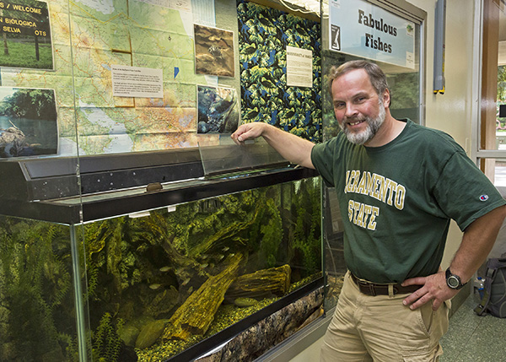
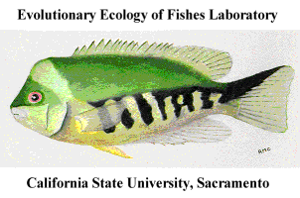
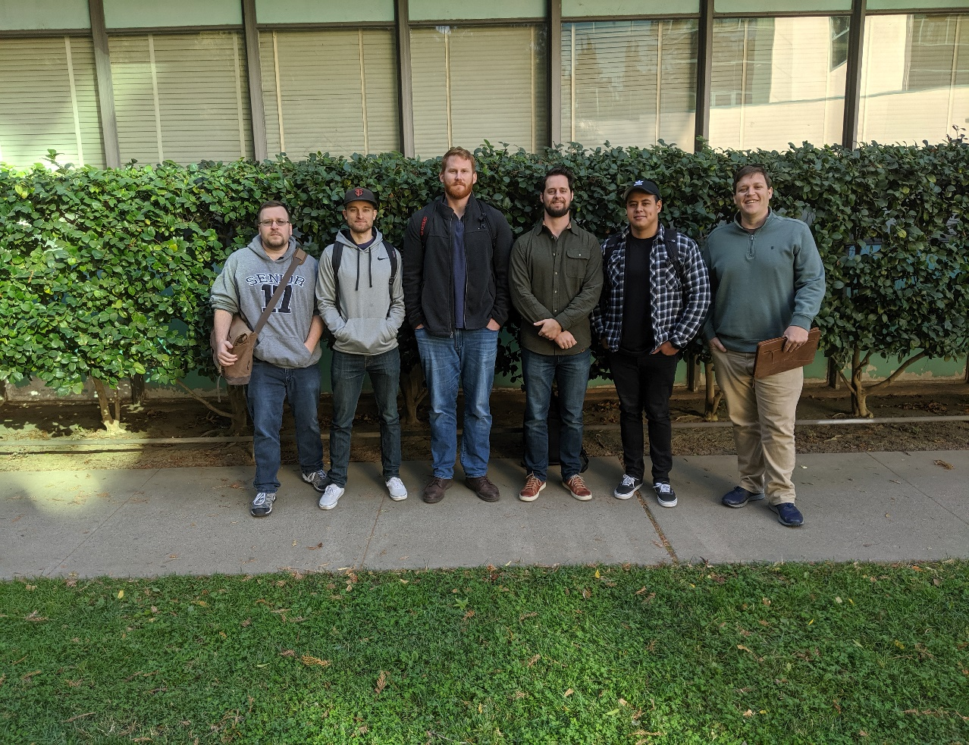
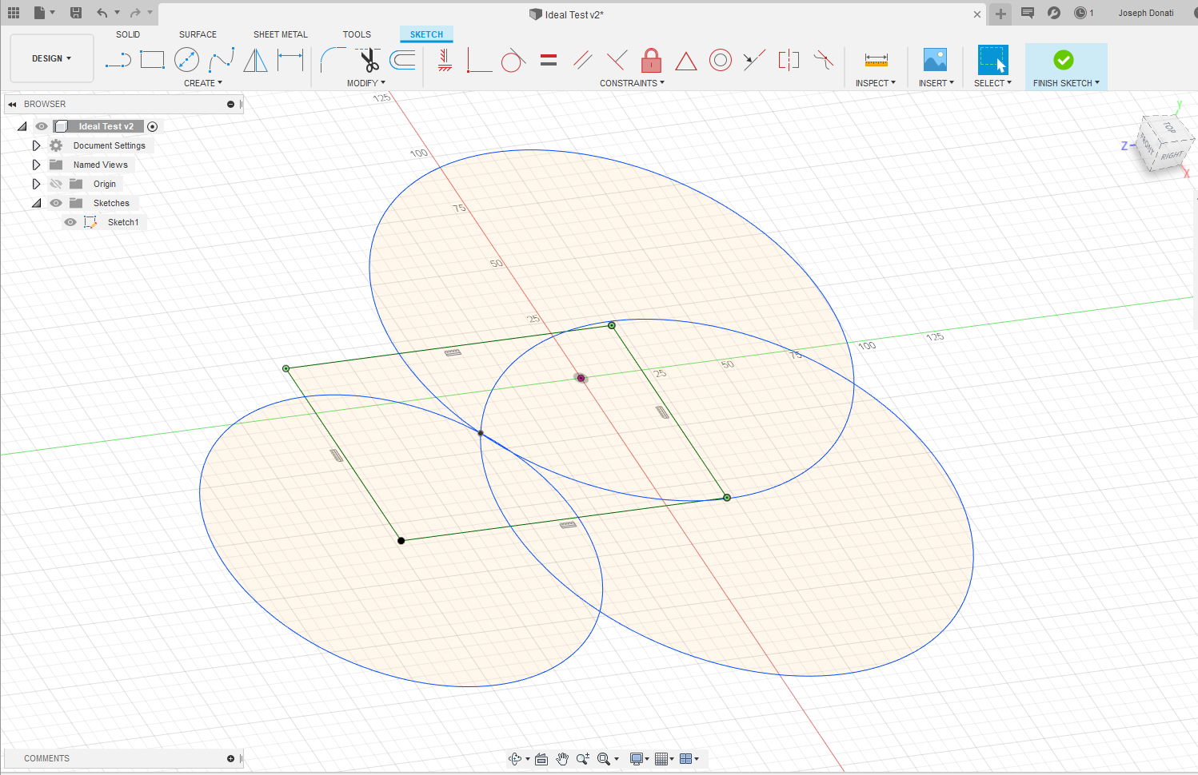
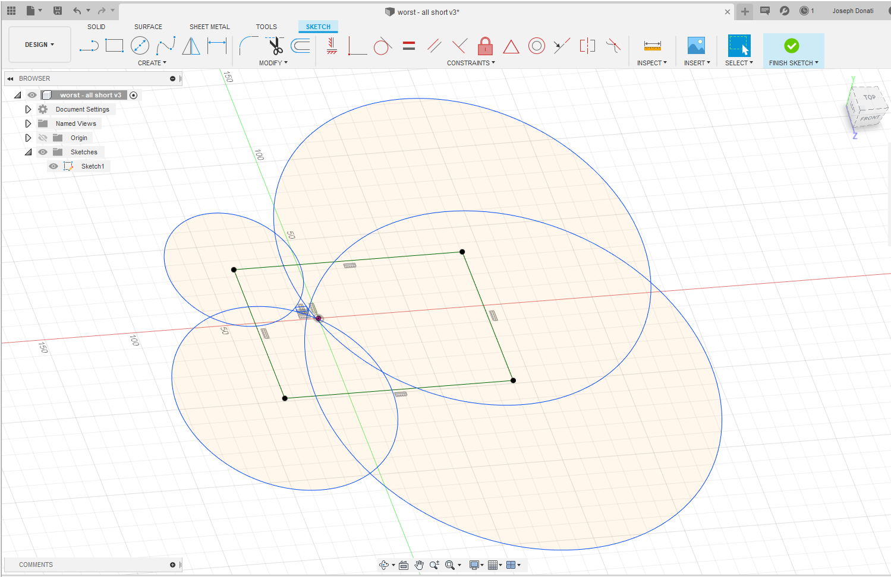
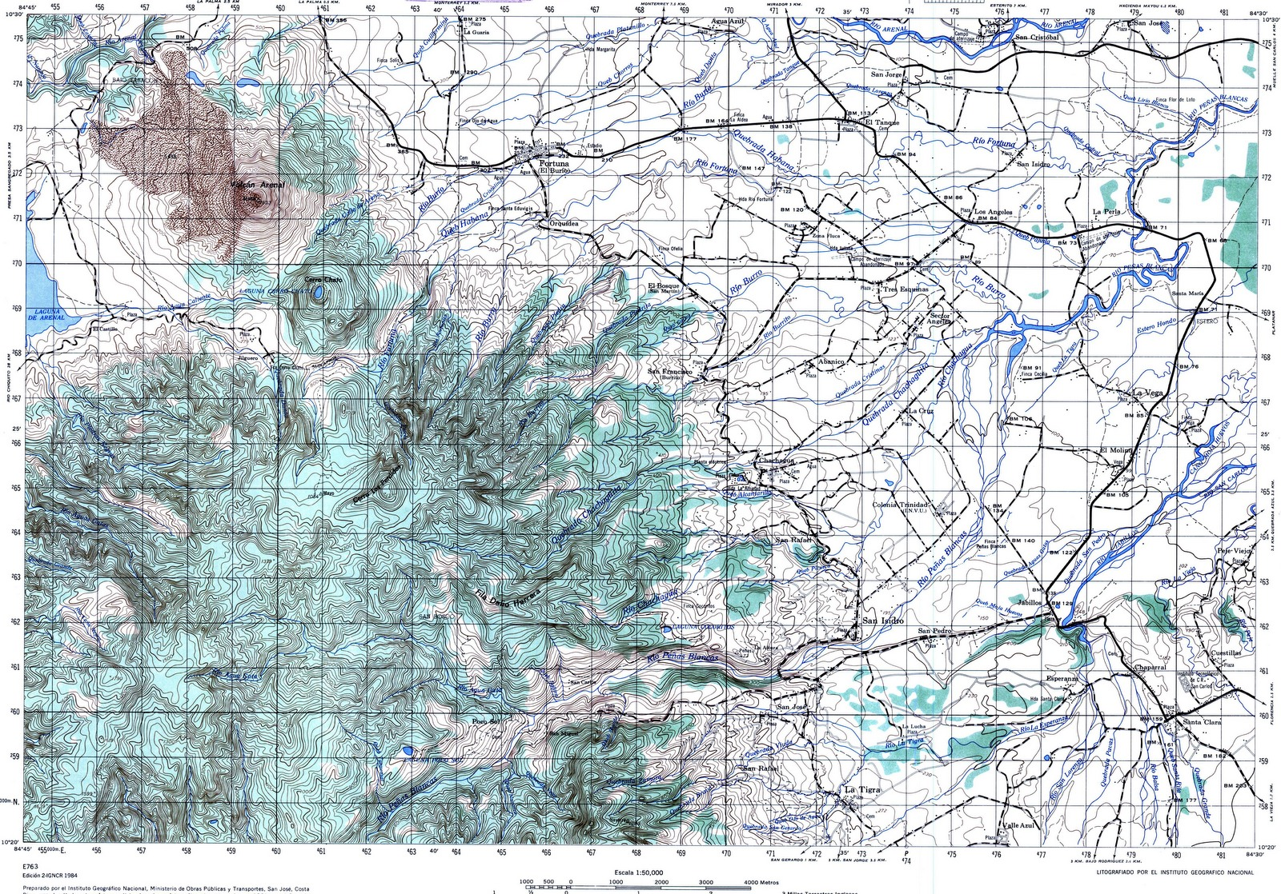
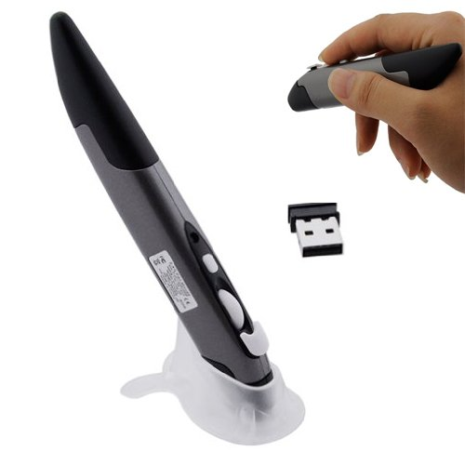
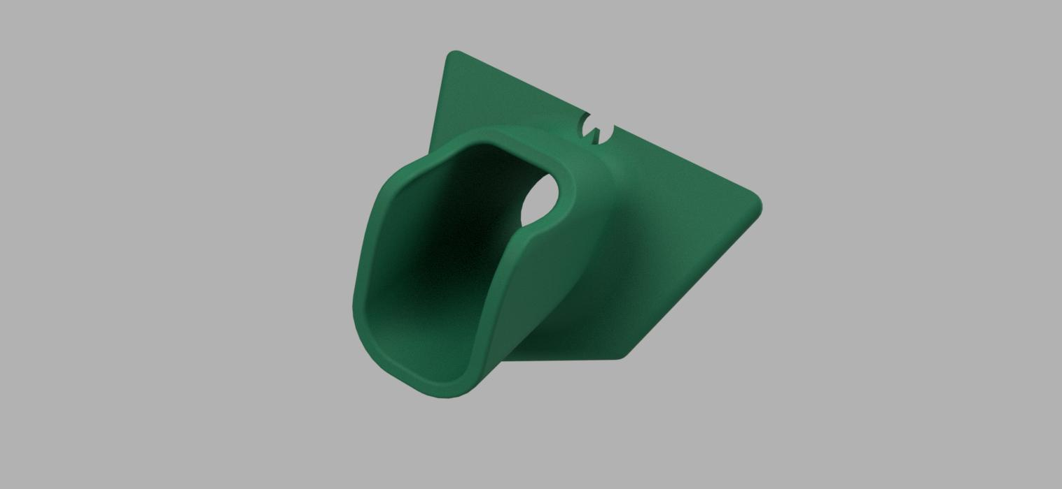
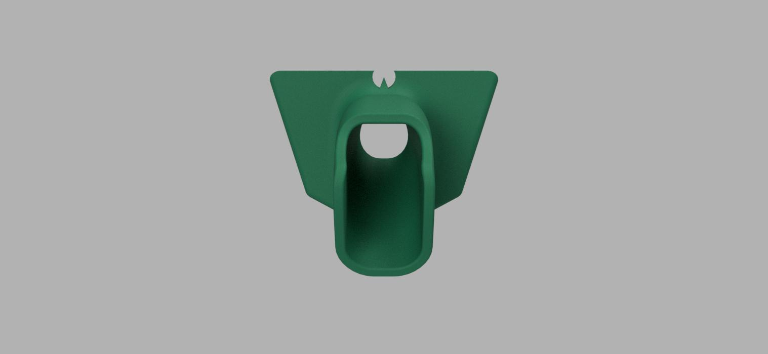
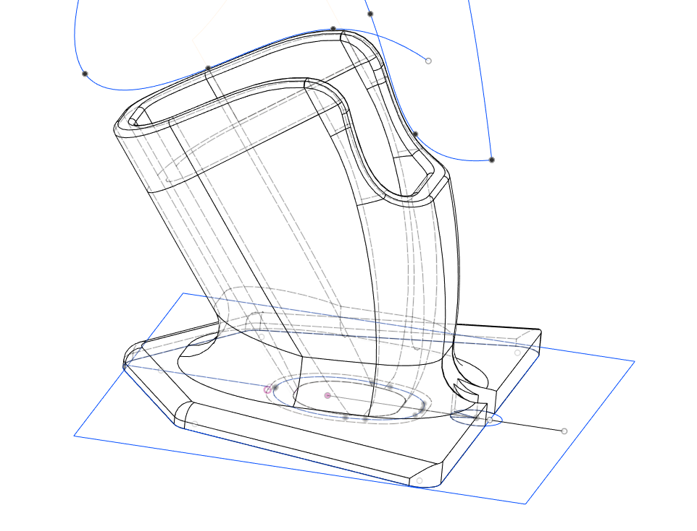
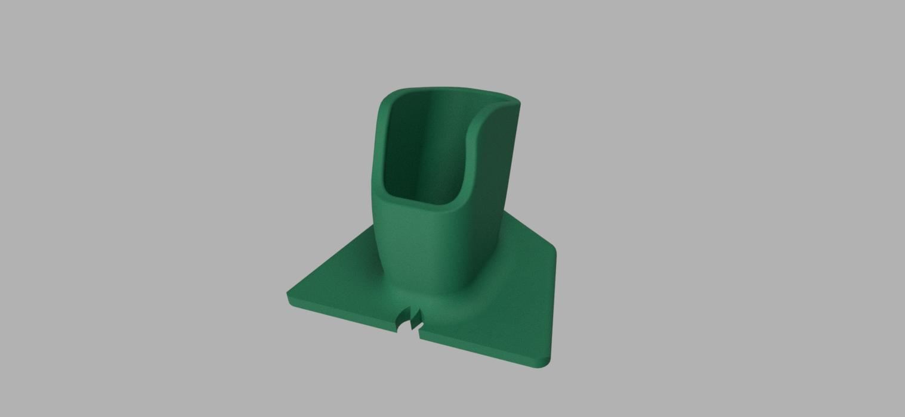
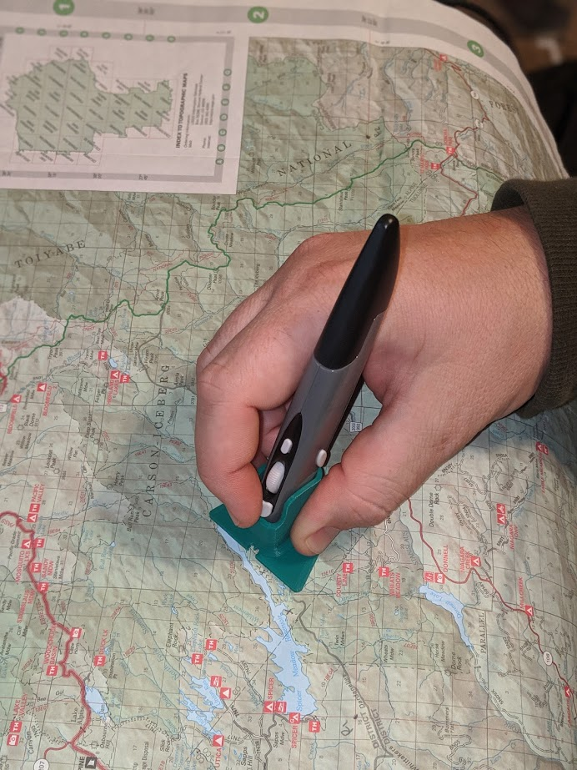
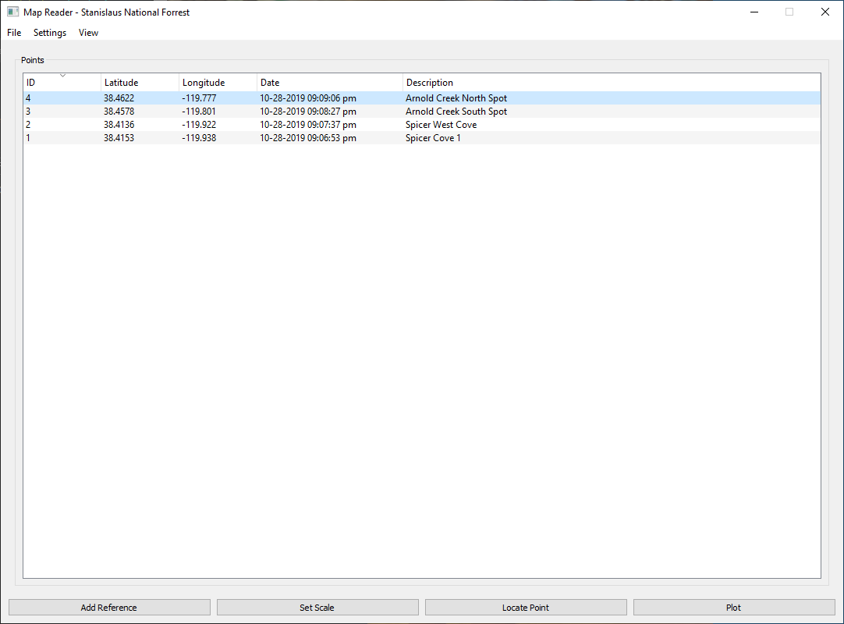
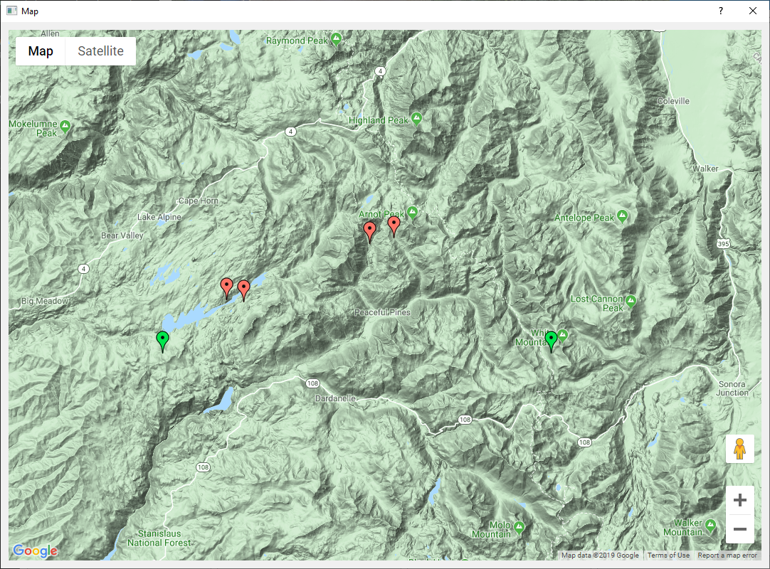
Capturing Geolocation Data Digitally by Tracing Field Maps
Gabriel Aguirre, Evan Brittain, Joseph Donati, Randall Plant, Ryan Swearingen, and Stanton Carlisle
Dr. Ronald M. Coleman
Professor, Biological Studies
Team DataDyne
Department of Computer Science, California State University, Sacramento
INTRODUCTION
RESEARCH AND DEVELOPMENT
CHALLENGES
Our client, Dr. Ronald Coleman, tasked our team with developing a solution to improve his field mapping workflow. As a biologist, his research often takes him to remote jungle locations in countries such as Costa Rica. Due to the outdated and inaccurate maps of the remote areas he works in, recording site locations is a tedious task. He sought a method to digitally record his geolocation data, but dense jungle canopies meant that a GPS logger was unfeasible.
Dr. Coleman came to us with this problem, as well as an optical wireless pen mouse (pictured below). He envisioned a system that would allow him to record locations on a paper map in the field and then digitize those points quickly at the end of each day. He asked us to design an application that could trace all the data points from his map with the pen mouse and then store them in a file for sharing and review.
To convert the optical pen mouse into a precision measuring instrument we faced several obstacles. We tested various methods for increasing the accuracy of the traced location, including measuring each point from multiple “reference points.” Reference points are selected on the paper map by the user, typically an easy to reference location, such as the intersection of the latitude/longitude gridlines. In order to devise a method for averaging the points we used CAD software to visually analyze how varying types and degrees of user error could affect raw data recorded by the mouse. Using constraints in parametric modeling software, we simulated the mouse movements in real-time to see if the geometry could work. (shown below).
Our initial challenges centered on the capturing of mouse data. To capture the raw mouse input required for our application we had to rely on system calls to interact with the Operating System directly. This low-level interaction was also necessary to ensure certain system variables, such as mouse acceleration, were not altering the raw data we recorded.
The inherent variability in the optical mouse hardware required us to devise a calibration function. Small differences in the resolution of the optical sensors (DPI) meant that each time a user switched to a different device the input would be different. Our solution allows for calibration of the hardware each time a new device or map is used. The scale is traced directly from the map to get a precise binding for each project.
Our final challenge came when trying to parse location data being traced from the map. There is no accurate way to display the spherical surface of the globe on a 2D paper map without distortion. Cartographers use different projection techniques to try and make their maps as accurate as possible, but these distortions mean that our method is accurate to the projected location, not to the actual location on the globe. This limitation is almost impossible to overcome without accounting for each possible projection method. This constraint means that when mapping small areas (city or county sized) the error caused by projection is small enough that it can be ignored. On large maps, like a map of a whole country, our product could give inaccurate results.
We discovered that we needed a way for the user to accurately orient the pen mouse to reduce error during tracing. We designed a removable, 3D-printed attachment for the mouse which gives the user a clear visual reference of the map location. The attachment also allows for the use of a straightedge for higher precision on large maps. We had to design multiple prototypes to get a tight fit on the mouse and find a base “foot” that would balance well in the user’s hand.
FINAL PRODUCT
Below is a photo of the final mouse attachment being used on a sample testing map. Prototypes of the location tables and Google Maps output are shown as well.
OBJECTIVES
Create a desktop application with a simple Graphical User Interface (GUI).
Record map information in a project file which can be stored locally on the user’s computer.
Develop a method for recording data points by tracing the map with the optical wireless mouse.
Allow the user to enter notes about each datapoint.
Allow the user to see data for each point after it is stored.
Export the project data to various filetypes (Excel, JSON, etc.)
TECHNOLOGIES IMPLEMENTED
Python programming language
PyQt5 application framework and GUI package
geopy geolocation data management package
pytest Python testing framework package
Google Maps API
Autodesk Fusion 360 modeling software
Cura 3D print slicer & 3D printing
BONUS OBJECTIVES
Create a graphical tutorial or video to teach new users how to operate the application precisely.
Allow the user to see a graphical representation of the stored map data (when internet access is available).

